Slide 1
디지털경제와 경영전략
Process Modeling

Slide 2
Learning Objectives
Understand the logical modeling of processes through studying data flow diagrams
How to draw data flow diagrams using rules and guidelines
How to decompose data flow diagrams into lower-level diagrams
Balancing of data flow diagrams
& Hands-on Practices
8.2

Slide 3
Process Modeling
Modeling a system’s process
  Utilize information gathered during requirements determination
  Structure of the data is also modeled in addition to the processes
Deliverables and Outcomes
  Set of coherent, interrelated data flow diagrams
  Project dictionary and CASE repository
8.<number>

Slide 4
Data Flow Diagram
EE1
External Entity
Name
D1
Data store
1.1
System process
description
Data Flow
Gane and Sarson Symbols

Slide 5
Data Flow Diagramming Definitions
Context Diagram
  A data flow diagram (DFD) of the scope of an organizational system that shows the system boundaries, external entities that interact with the system and the major information flows between the entities and the system
Level-O Diagram
  A data flow diagram (DFD) that represents a system’s major processes, data flows and data stores at a high level of detail
8.<number>

Slide 6
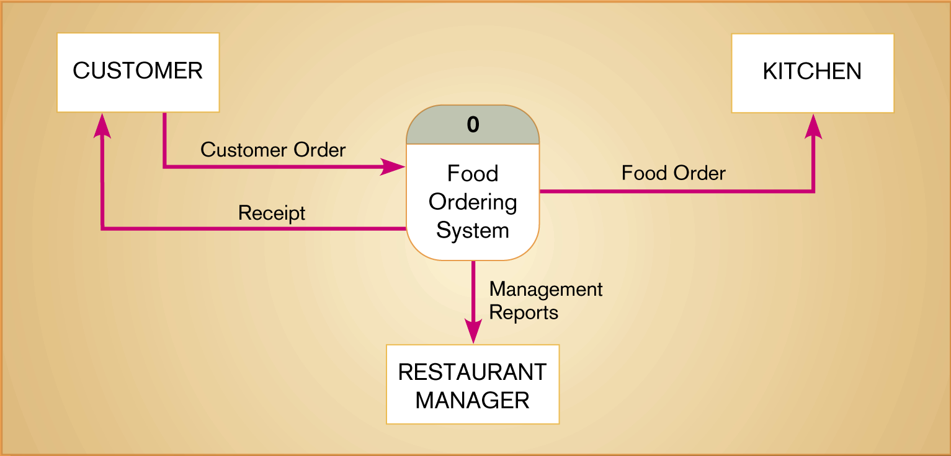
Figure 8-4
Context diagram of Hoosier Burger’s food ordering system
8.<number>

Slide 7
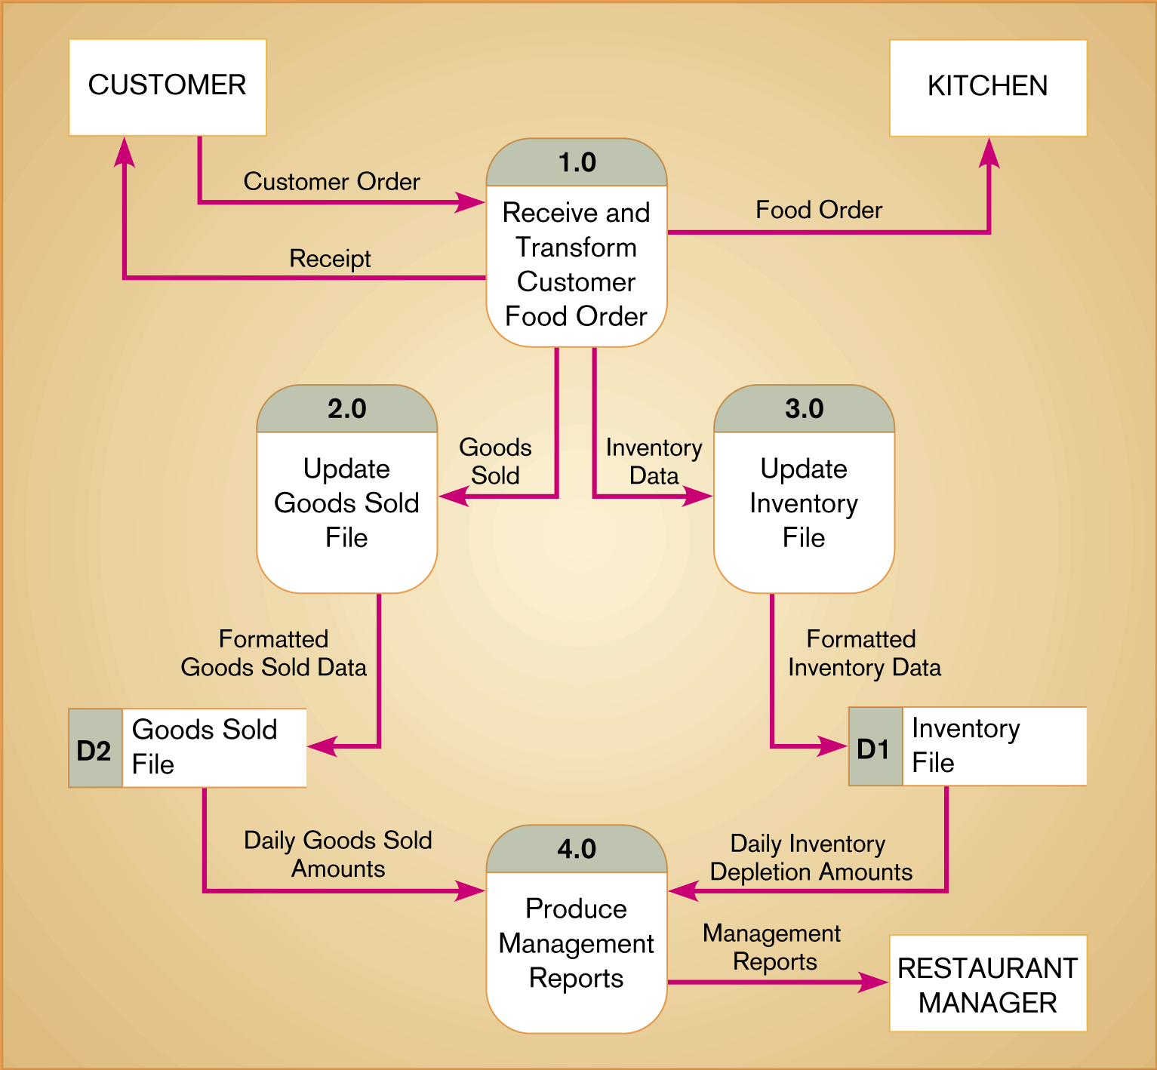
Figure 8-5
Level-0 DFD of Hoosier Burger’s food ordering system
8.<number>

Slide 8
Nested DFD
Level 0
EE1
1.0
2.0
D1
Level 1
Level 1
EE1
1.1
D2
D1
2.1
2.2
1.2
Level 2
2.3
1.2.1
1.2.2

Slide 9
Data Flow Diagramming Rules
Basic rules that apply to all DFDs
  Inputs to a process are always different than outputs
  Objects always have a unique name
    In order to keep the diagram uncluttered, you can repeat data stores and sources/sinks on a diagram
8.<number>

Slide 10
Data Flow Diagramming Rules
Process
  Every data flow must begin or end at a process
  No process can have only outputs (a miracle)
  No process can have only inputs (black hole)
  A process has a verb phrase label
Data Store
  Data cannot be moved directly from one store to another
  Data cannot move directly from an outside source to a data store
  Data cannot move directly from a data store to a data sink
  Data store has a noun phrase label
8.<number>

Slide 11
Data Flow Diagramming Rules
Source/Sink
  Data cannot move directly from a source to a sink
  A source/sink has a noun phrase label
Data Flow
  A data flow has only one direction of flow between symbols
  A fork means that exactly the same data goes from a common location to two or more processes, data stores or sources/sinks
8.<number>

Slide 12
Data Flow Diagramming Rules
Data Flow (Continued)
  A join means that exactly the same data comes from any two or more different processes, data stores or sources/sinks to a common location
  A data flow cannot go directly back to the same process it leaves
  A data flow to a data store means update
  A data flow from a data store means retrieve or use
  A data flow has a noun phrase label
8.<number>

Slide 13
Decomposition of DFDs
Functional decomposition
  Act of going from one single system to many component processes
  Repetitive procedure
  Lowest level is called a primitive DFD
Level-N Diagrams
  A DFD that is the result of n nested decompositions of a series of subprocesses from a process on a level-0 diagram
8.<number>

Slide 14
Balancing DFDs
When decomposing a DFD, you must conserve inputs to and outputs from a process at the next level of decomposition
This is called balancing
Example: Hoosier Burgers
  In Figure 8-4, notice that there is one input to the system, the customer order
  Three outputs:
    Customer receipt
    Food order
    Management reports
8.<number>

Slide 15
Balancing DFDs
Example (Continued)
  Notice Figure 8-5. We have the same inputs and outputs
  No new inputs or outputs have been introduced
  We can say that the context diagram and level-0 DFD are balanced
8.<number>

Slide 16
Balancing DFDs
An unbalanced example
  Figure 8-10
  In context diagram, we have one input to the system, A and one output, B
  Level-0 diagram has one additional data flow, C
  These DFDs are not balanced
8.<number>

Slide 17

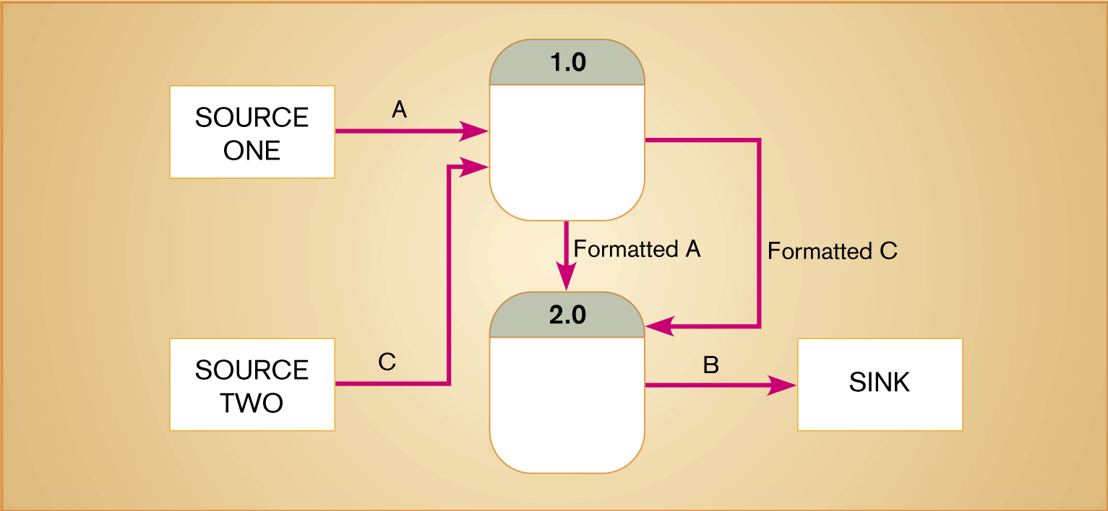
Figure 8-10
An unbalanced set of data flow diagrams
(a) Context diagram
(b) Level-0 diagram
8.<number>

Slide 18
Balancing DFDs
We can split a data flow into separate data flows on a lower level diagram (see Figure 8-11)
Balancing leads to four additional advanced rules (See Table 8-3)
8.<number>

Slide 19

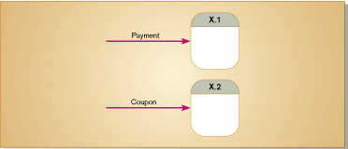
Figure 8-11

Slide 20
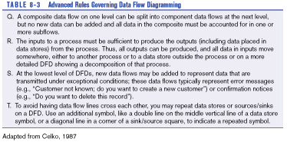
Table 8-3 (p. 244)

Slide 21
Four Different Types of DFDS
Current Physical
  Process label includes an identification of the technology (people or systems) used to process the data
  Data flows and data stores are labeled with the actual name of the physical media on which data flow or in which data are stored
Current Logical
  Physical aspects of system are removed as much as possible
  Current system is reduced to data and processes that transform them
8.<number>

Slide 22
Four Different Types of DFDS
New Logical
  Includes additional functions
  Obsolete functions are removed
  Inefficient data flows are reorganized
New Physical
  Represents the physical implementation of the new system
8.<number>

Slide 23
Guidelines for Drawing DFDs
Completeness
  DFD must include all components necessary for system
  Each component must be fully described in the project dictionary or CASE repository
Consistency
  The extent to which information contained on one level of a set of nested DFDs is also included on other levels
8.<number>

Slide 24
Guidelines for Drawing DFDs
(p. 262)
Timing
  Time is not represented well on DFDs
  Best to draw DFDs as if the system has never started and will never stop.
Iterative Development
  Analyst should expect to redraw diagram several times before reaching the closest approximation to the system being modeled
8.<number>

Slide 25
Guidelines for Drawing DFDs
Primitive DFDs
  Lowest logical level of decomposition
  Decision has to be made when to stop decomposition
8.<number>

Slide 26
Guidelines for Drawing DFDs
Rules for stopping decomposition
  When each process has been reduced to a single decision, calculation or database operation
  When each data store represents data about a single entity
  When the system user does not care to see any more detail
8.<number>

Slide 27
Guidelines for Drawing DFDs
Rules for stopping decomposition (continued)
  When every data flow does not need to be split further to show that data are handled in various ways
  When you believe that you have shown each business form or transaction, on-line display and report as a single data flow
  When you believe that there is a separate process for each choice on all lowest-level menu options
8.<number>

Slide 28
Using DFDs as Analysis Tools
Gap Analysis
  The process of discovering discrepancies between two or more sets of data flow diagrams or discrepancies within a single DFD
Inefficiencies in a system can often be identified through DFDs
8.<number>

Slide 29
Using DFDs in Business Process Reengineering
Example: IBM Credit (p. 265)
  See Figure 8-20 – before reengineering
  Credit approval process required six days before BPR
  Figure 8-21 depicts DFD after reengineering
  IBM was able to process 100 times the number of transactions in the same amount of time
8.<number>

Slide 30
Oracle’s Process Modeler and Functional Hierarchy Diagrams
Process Modeler
  Unique to Oracle
  Similar to DFDS but outputs and methods differ in several ways.
  Table 8-4 illustrates differences
Functional Hierarchy Diagrams
  Picture of various tasks performed in a business and how they are related
  Tasks are broken down into their various parts
  Does not include data flows
8.<number>

Slide 31
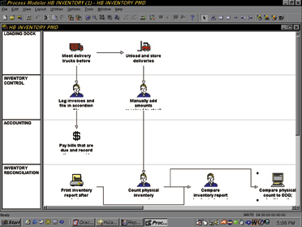
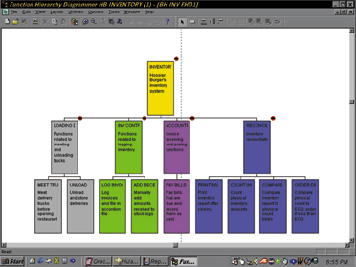

Slide 32
A Simple DFD Example:
Customer Order Process for CD On-Line
  Customers select the CDs they would like to order and communicate their selected CD item numbers and their customer account number to CD On-Line. Based on the customer’s selection, the order is processed by calculating the order total amount.
  The order total and customer account number as well as the customer’s old credit balance (from the customer credit database) are used to update the customer’s new credit balance. The new balance should be recorded on the customer credit database.

Slide 33
A Simple DFD Example:
Customer Order Process for CD On-Line (cont’d)
  The detailed order data from order processing and updated customer credit balance information are used to prepare a customer invoice and invoice information is updated. Detailed invoice data are used to prepare a shipping list and the invoice is sent to the customer on-line. The shipping list information is sent to UPS. (Based on a partnership relationship between CD On-Line and UPS, UPS warehouses the CDs and ships the CDs to the customers based on the shipping list).

Slide 34
Translating into DFD Vocabulary
External Entities
  Customer
  UPS
  Internal Entity: CD On-Line
Data Store
  Customer credit

Slide 35
Translating into DFD Vocabulary
Process
  Compute order total
  Update customer credit account balance
  Prepare invoice
  Prepare shipping list
Data Flows
  CD item numbers
  Customer account number
  Old/New balance
  Order data

Slide 36
Data Flow Diagram
1
Compute
order total
2
Update
customer credit
account balance
EE1
Customer
CD item numbers
Order data
Customer Acct
number
Old
balance
New
balance
D1 Customer credit
Order data
Invoice
3
Prepare
invoice
Invoice
Invoice
EE2
UPS
Shipping list
4
Prepare
shipping list
D2 Invoice Folder

Slide 37
An Exercise on Your Own 1
Customer Payment Process for CD On-Line
  Customers make payments for their purchases by sending checks along with their customer account numbers. The payments are processed by recording the payment.
  The payment data as well as the customer’s old credit balance (from the customer credit database) are used to update the customer’s new credit balance. The new balance should be recorded on the customer credit database. Also, a receipt is sent to the customer.
  The payment data from payment recording processing are used to make bank deposit. The deposit data are sent to banks.

Slide 38
An Exercise on Your Own 2
Pizza Ordering Process for Perfect Pizza
  When Regular customers call Perfect Pizza on the phone, they are asked their phone number. When the number is typed into a computer, the name, address, and last order date from Order History data is automatically brought up on the screen by customer representive. Once the detail of the order is taken, the total, including tax and delivery, is calculated by customer representive. Then, a receipt per order is printed to driver and the detail of the order is given to the cook. The cook prepare the order. Then the cook give the order information to drivers who make deliveries give customers a copy of the receipt.

